Slide 1
Project Update
Date 3/10

Slide 2
Week 3/3 - 3/10
Downloaded 20+ k images from the API
Did Data analysis ( more on this later)
Thought about labeling ( need ground truth)
Tried Google Earth API
Lookup table and renaming of the images
Hiccups
VM is not supportive of deep learning libraries. No GPU.
Haven’t gotten back from the provisioned ACER.
Earth API zoom function wasn’t working properly.

Slide 3
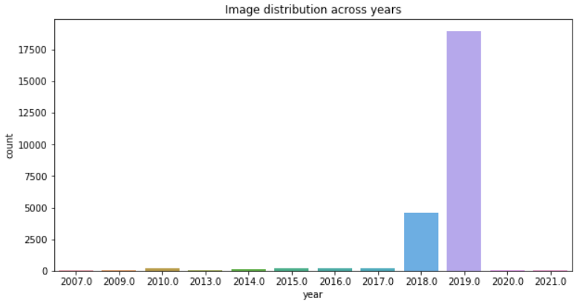
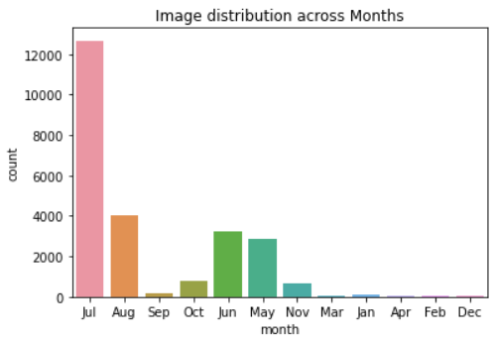
Data Analysis
The images we have are from Jul, Aug, June, May.
This assures the images are in clear weather, however, data of the problematic it seems.
Fewer snow periods or harsh climate images which could possibly challenge the integrity of the models created ? No.
The images we have from GSV range from 2007 to 2021. However, the images from 2018+ capture 95.5% of the images.
Decision; Should we filter out the images less than 3 years old ? keep it.

Slide 4
Utility Pole Labeling Approach
Approach 1: Manually labelling 20k images. ( 6 pole containing images per 100 images)
Approach 2: Find out another dataset with the street view images, train the model on those images, and treat our grid images as test dataset to label them.
Or
Find pre-trained model and use those for our object detection, however the accuracy is difficult to define due to absence of ground truth.
-- google’s ImageNet ( tensorflow and keras)
Approach 3: Near Duplicate detection. ( pinterest image similarity method; https://medium.com/pinterest-engineering/detecting-image-similarity-using-spark-lsh-and-tensorflow-618636afc939 )

Slide 5
Approach 3 in detail
Say we have total images N, and images containing poles M {M ∈ N}.
We Select m images, manually, such that m ∈ M.
Preprocess m images such that the background is distinct to utility pole. (edge detection openCV)
Learn the features of the images. (CNN architectures VGGnet, Inception, etc.)
Find similarity matrix {mxm}. (Cosine Similarity)
Plot the distribution of the similarity matrix. (intuitively a skinnier normal distribution)
Get the threshold (hyperparameter) above which the images are similar.
Issues:
What would be a good m ?
Threshold measure?
Reduction of false negatives.

Slide 6
Next week
Approach 2 and 3 viability test.
GPS - ArcGIS like esri see if we can leverage it.
GPS location maths. Of poles. approach.

